Slide 1

Claude Code and the Future of AI in tech and cybersecurity
By: Dennis Freyman
Cybersecurity Club 2025-2026

Slide 2

Explosive Growth & Market Impact
500M
10x
#1
Annual Revenue
Usage Growth
Growth Rate
Reached within months of May 2025 launch
Surge in just three months
Fastest-growing AI coding tool

Slide 3
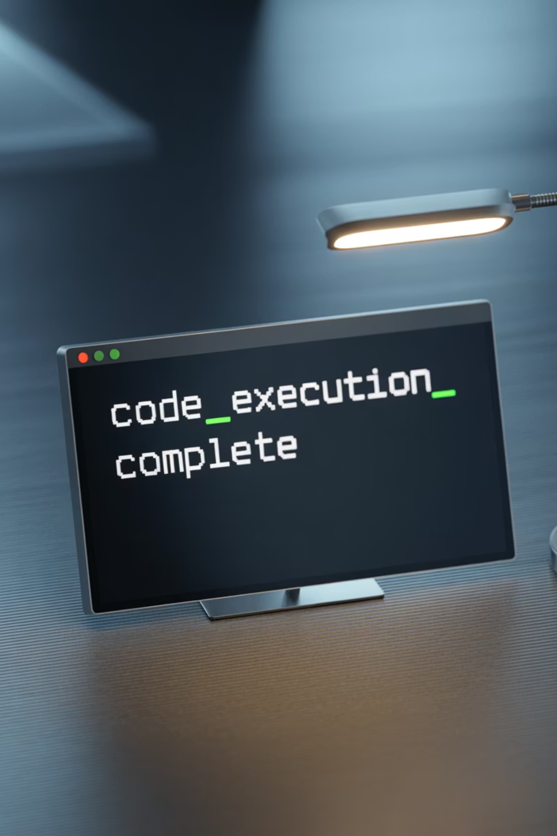






What is Claude Code?
Agentic AI Assistant
Full Autonomy
Integrated directly into developer terminals for seamless workflow integration
Reads, edits, tests, commits, and pushes code independently
Lightweight Design
Conversational and cloud-agnostic — no heavy IDE setup required

Slide 4


Slide 5




How much AI in FAANG+M
Meta is on track for AI to write about 50% of its code within the next year Zuckerberg
Artificial intelligence now writes a quarter of all code (nearly 25%)(as of July, rapidly increasing)
AI is now writing 50% of the code at Google
Microsoft CEO Satya Nadella stated that up to 30%
CEO Sundar Pichai
(as of April, rapidly increasing, definitely higher)
we dont know about the other companies

Slide 6






Why computer science then my job is gone
You are right
jobs are cooked
Could be a similar surge to the internet
lots of jobs gone, lots of new ones
New Skills Required, coding is essentially obsolete
AI prompt engineering and test-driven development
Everything points to a more individualized job market:
70–80% of YCombinator companies are based on AI,
Giant startup boom
AI-related startups, with estimates for the global total reaching between 50,000 and 70,000 in 2025

Slide 7

Security and Ethical Implications
With great power comes great responsibility

Slide 8

Agentic AI & Security Risks
Autonomous AI Access
Automated Penetration Testing
Claude Code's ability to explore files and run batch commands raises potential hacking concerns. ARGUS, similar tools definitely already in circulation.
Potential for "agentic" hacking if misused by bad actors. promt engineering is a real issue.

Slide 9

AI for defensive security
01
The start of agentic security firewalls, SIEMs, etc
The future of security, but then the AI is the bottleneck
02
The jobs
The job becomes not security but monitoring the AI. What is even society at that point
03
Cyberpatriot, USACO, CTFs, etc.
how do we measure ability? what are competitions?
the future

Slide 10

AI Adoption Trends in Coding & Beyond
Programming
Education
Research
Regular Users
Coding remains the top AI use case globally, while education usage has grown from 9.3% to 12.4%. Geographic adoption is concentrated in high-income regions, with the US, Singapore, and Canada leading per capita usage.

Slide 11
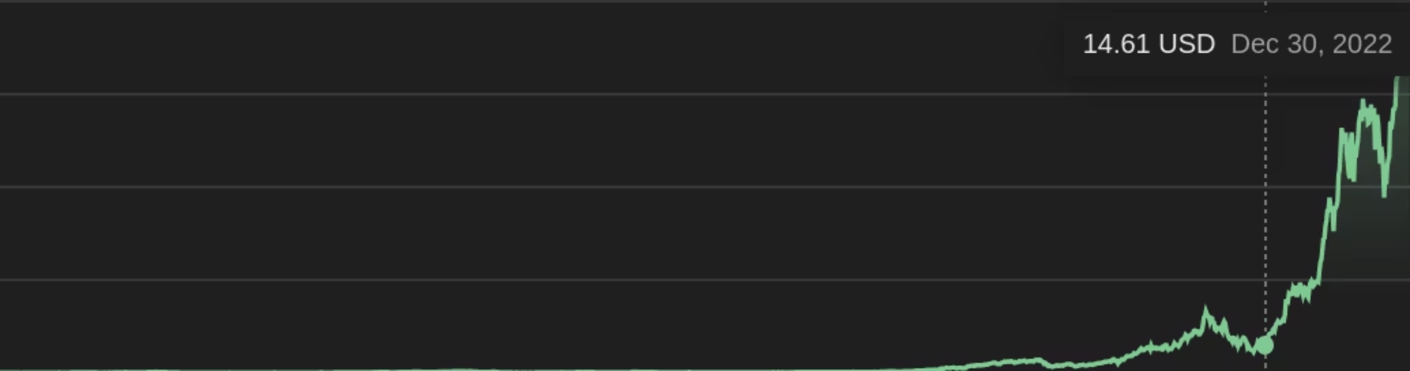
The economy: NVIDIA and others
Claude
Cursor
Open AI
Sonnet, Opus 4 model superiority
GUI-heavy interface design
most popular general public AI
heavily programmer focused
Traditional IDE integration
Less autonomous operation
also general use
Visual coding assistance focus
less programmer focused
$183 billion
dying
$500 billion
$9.9 billion

Slide 12
Software engineering (AI code assist & test generation), Cyber threat detection & response, Data engineering/ETL automation, MLOps & model lifecycle management, Electronic design automation (EDA) for semiconductors, Chip verification & synthesis, Computer vision for inspection/surveillance, Natural language processing (search, summarization, Q&A), Speech recognition (ASR) & speech synthesis (TTS), Recommender systems for retail/media, Performance ad targeting & bidding (adtech), Marketing mix modeling & attribution, Payments fraud detection & chargeback prevention, Identity verification & KYC/AML, Quant trading & alpha research, Credit risk scoring & underwriting, Insurance pricing & claims automation, Revenue cycle management (healthcare billing/coding), Medical imaging diagnostics (radiology CT/MRI), Computational pathology (WSI slide analysis), Clinical decision support & triage, Drug discovery (generative chemistry/ADMET), Protein structure/design (folding, binder design), Clinical trial design & patient matching, Genomics variant calling & annotation, Single-cell omics analysis, Proteomics mass-spec interpretation, Materials informatics (property prediction), Battery/materials discovery (electrochemistry), Process mining & operations optimization, Supply chain network & demand forecasting, Route optimization & last-mile logistics, Warehouse robotics (picking/sorting), Inventory optimization & demand sensing, Predictive maintenance (industrial IoT), Visual quality inspection (manufacturing), CAD generative design & topology optimization, Structural simulation & digital twins, Energy load forecasting & grid optimization, Renewable output forecasting (solar/wind), Demand response & DER orchestration, Oil & gas seismic interpretation & drilling optimization, Mining ore body modeling & haul optimization, Telecom network planning & RAN optimization, AIOps/IT incident prediction & remediation,

Slide 13
Cloud cost optimization (FinOps with AI), Real-estate automated valuation models (AVMs), Dynamic pricing & revenue management (airlines/hospitality), E-commerce search/ranking & merchandising, Returns triage & intent prediction, Customer support automation & deflection, Sales SDR automation & lead scoring, Contract analysis & clause extraction (legal tech), eDiscovery document review, Compliance monitoring & regulatory mapping, Document processing & intelligent OCR, Translation, localization & AI dubbing, Content moderation & brand safety, Synthetic media detection & authenticity, Sports performance analytics & player tracking, Broadcast highlight detection & automation, Film/TV post-production (roto, upscaling, denoise), Game asset generation & QA automation, Music transcription, separation & mastering assist, Geospatial change detection & land-use mapping, Disaster damage assessment from satellite/aerial, Climate downscaling & weather forecast correction, Precision agriculture (yield, disease, variable-rate), Aquaculture feed & health optimization, Transportation timetabling & crew scheduling, Autonomous driving perception & simulation, Fin crime investigations & network analytics, Healthcare prior authorization automation, Prior-auth & coding denials prediction, Call center QA & compliance scoring, Meeting transcription/action extraction, Talent sourcing & resume screening, Learning content generation & auto-grading (edtech), Safety incident analysis & hazard prediction, Digital forensics (image/audio/log triage), Email security & phishing detection, IoT anomaly detection, Battery management system analytics, Pharma pharmacovigilance signal detection, Retail footprint optimization (site selection), Churn prediction & retention modeling, Churn-aware personalization, Social listening & trend detection, News aggregation & fact-aid tools, Code search & vulnerability discovery, PCB layout/routing assist, 3D reconstruction & metrology, Optical character recognition at scale (forms, invoices), Knowledge base synthesis & retrieval-augmented QA, Multimodal document understanding (tables/figures), Synthetic data generation for testing/training, Workforce scheduling & labor optimization, Cash forecasting & treasury analytics, Portfolio risk & scenario modeling, Tax document extraction & prep automation, Shipping container stowage & port scheduling, Airline maintenance planning optimization, Network traffic forecasting & CDN routing, Smart meter analytics & theft detection, Medical scribe & ambient clinical documentation, Pathway modeling & systems biology, Imaging reconstruction (MRI/CT acceleration), Robotic process automation with LLMs (complex workflows), Security log correlation & SIEM enrichment, Email/CRM personalization at scale, Knowledge graph construction & entity resolution, Patent landscaping & prior-art search, Grant/peer-review triage & scoring, Accessibility captioning & real-time transcription, OCR for historical archives & digitization, Sensor fusion for drones/UAV mission planning

Slide 14

Conclusion: Claude Code's Promise and Challenges Ahead
1
Present Innovation
Automating complex coding with human oversight, accelerating development cycles
2
Industry Transformation
Shifting developer roles and reshaping tech workflows across organizations
3
Future Partnership
AI as true coding partner — faster, smarter, and more secure software creation
4
When does it become too much?

Slide 15
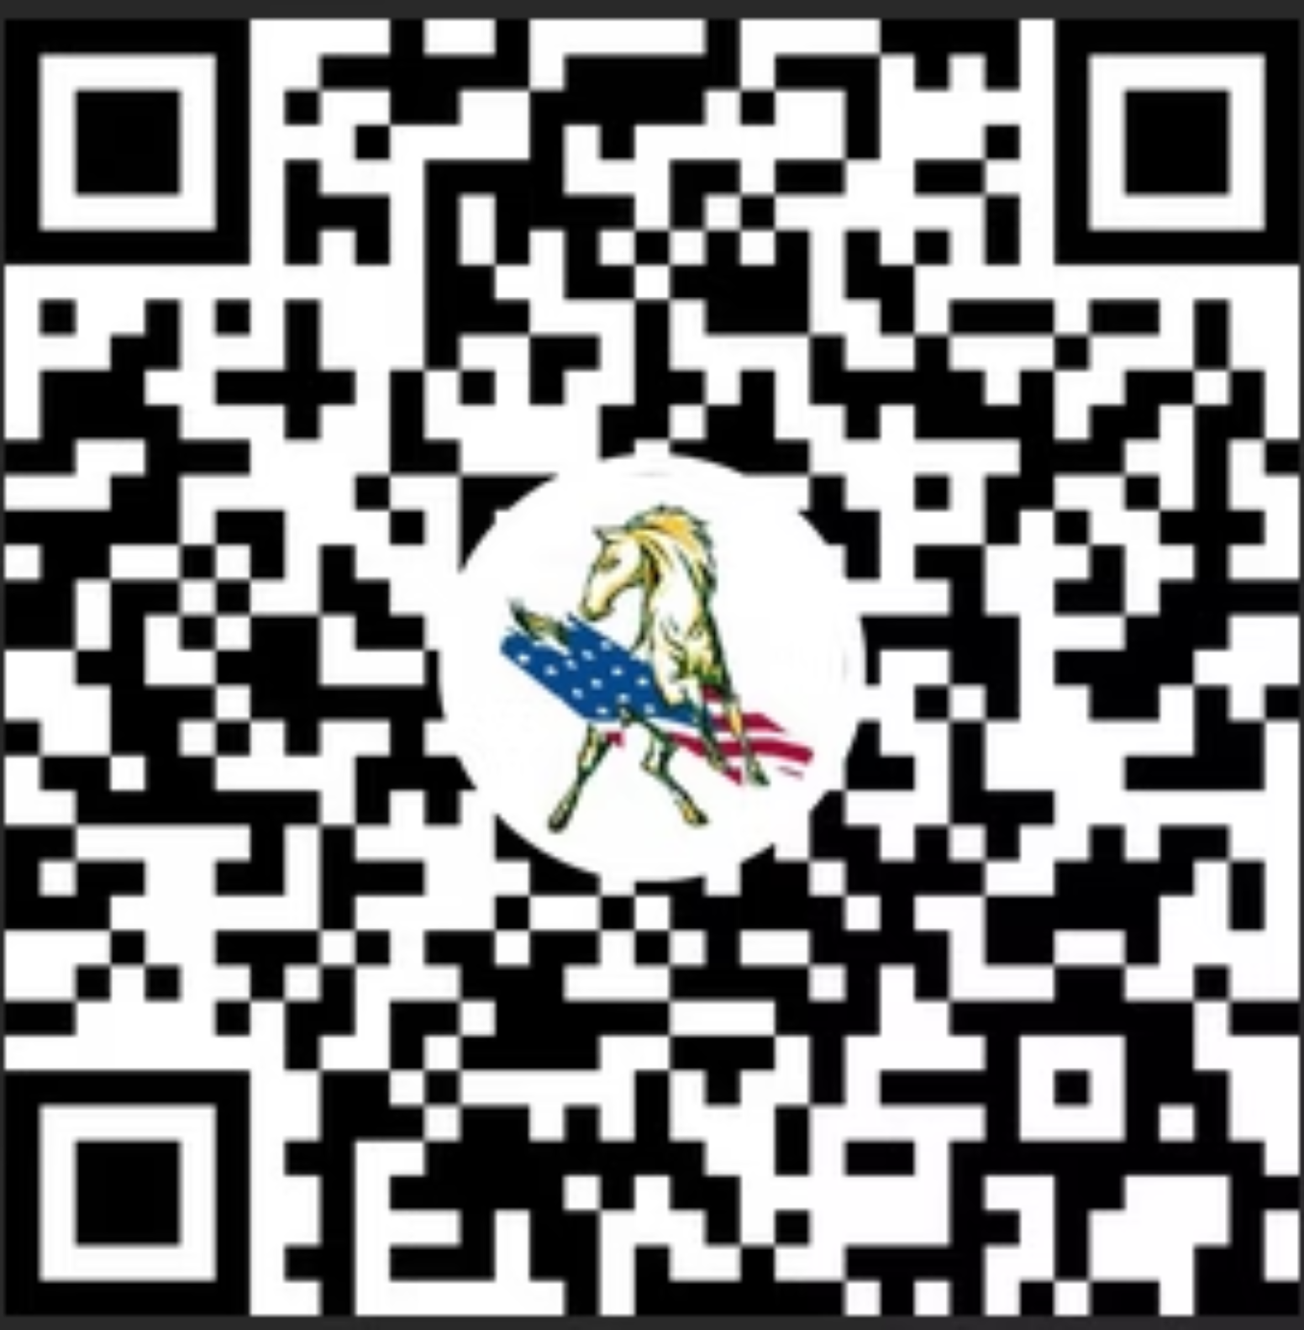
thanks for coming!

